Slide 1
Week 2 CIS 215
Recon

Slide 2
Start gathering info
Work from non-invasive (OSINT) up to more invasive tools (PING)
What sources are useful?
Cached pages
Keywords and file specific (passwords, RSA token, *PDF etc.)
What pieces of data are we looking for?
Think high level before you deep dive
Footprint
What's visible from the outside?

Slide 3

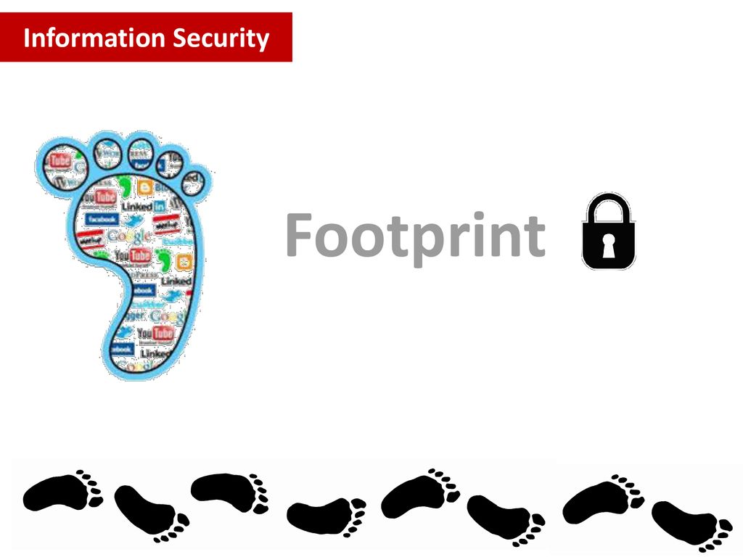
Footprint
DNS Nameservers
IP Ranges
Banners
Operating Systems
IDS/IPS and other security systems
Network Devices
Other Devices and job postings
Mobile Opportunities
Buckets of Data

Slide 4
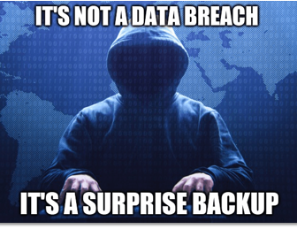
What data are we looking for?
Names
Jobs
Emails
Personal info
Documents
Financials, company structure

Slide 5
Activity
Let's start with Open Source Intelligence (OSINT)
What can Google tell us about NECC?
How can we make Google tell us more?
Where can we look beyond Google (What other search engines have you tried?)
Start a MindMap on the board of what you've found

Slide 6

Let's get more invasive
DNS
Servers
Automated Collections of data and web scraping
Metadata
Documents Posted? Who wrote them
Pictures posted? Who took them and where?
Jobs listed? What tools/services do we use?

Slide 7
DNS Recon
Dig - domain information groper
fierce – Brute force approach
Nslookup – less info, but almost always available
Nameservers
wildcard sub-domains, word lists for sub-domains
Alternate Nameservers
DNSSEC
Originally DNS had no security built in
Doesn't protect confidentiality, only for protection against forged or manipulated DNS data

Slide 8
Activity
Try some Tools
Passive scans ONLY right now
Whois IPADDRESS
Dig URL
Fierce – dns URL
Nmap IPADDRESS <-- Caution! Caution!
Dnsenum URL
Dnsrecon –d URL
Everyone find 1-2 more passive tools, explain how they work and how they avoid detection

Slide 9
Traps
Honey traps (Older term was HoneyPot, can offend people)
Example: Email only seen by scraper can be monitored to detect activity
Fake Social Media Accounts for "Employees"
Junk info to detect scraping
White text on white background
Small text
Be careful of Accessibility!
How to defeat scrapers
Jane@doe.com vs Jane at doe dot com, vs CEO at doe dot com
Limit searching by timeout, IP or Browser headers

Slide 10
Reporting
Reports are the least fun and most needed part of the job
They are what you turn in at the end, shows what worked and what didn't.
Open office
Easy to use
Doesn't like weird data (PCAP, nmap scans etc)
Unwieldy at large volume
Magic tree
Straightforward data consolidation
Uses a tree structure for organization
Dradis – The one we'll be using, has better documentation

Slide 11
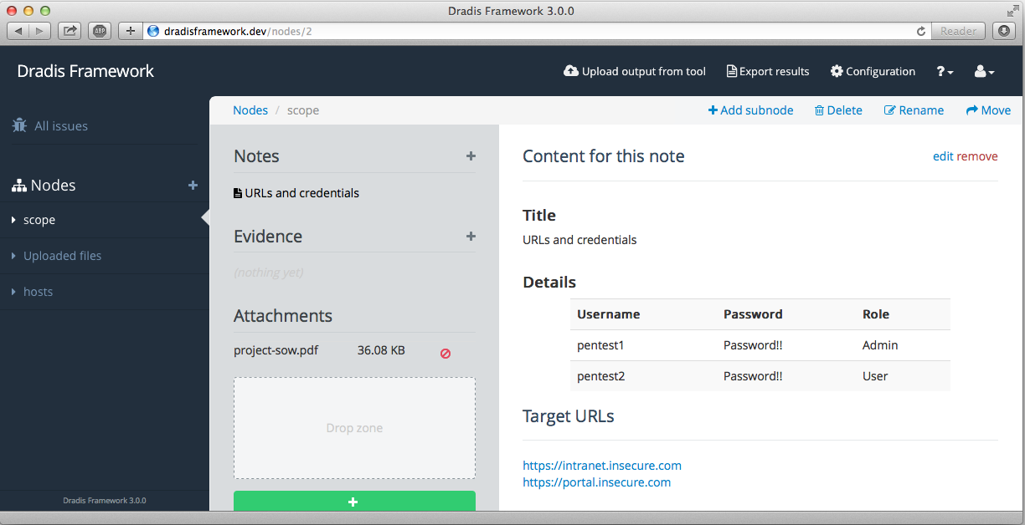
Dradis
Nodes
In place of folders for organization
Issues
Vulnerabilities found
Methodologies
Checklists and time lines, think project management
Uses an IP address or website so it's easy to share with a team

Slide 12
Activity
Start up Dradis and start your first report. You'll be creating a report on the Pen test of the school
Dradis has a community edition
Start your report and upload the data you collected from the passive scans and your notes from OSINT recon
https://dradisframework.com/ce/documentation/

